Slide 1
Financial Risk Modeling With Deep Learning
Phase I Presentation
FE800
Spring 2018
3/1/2018
Team VIXXX (Group 7)
Advisor: Dr. Khaldoun Khashanah
Jiaji Dai
Shuda Wang
Huanghaotian Fu

Slide 2
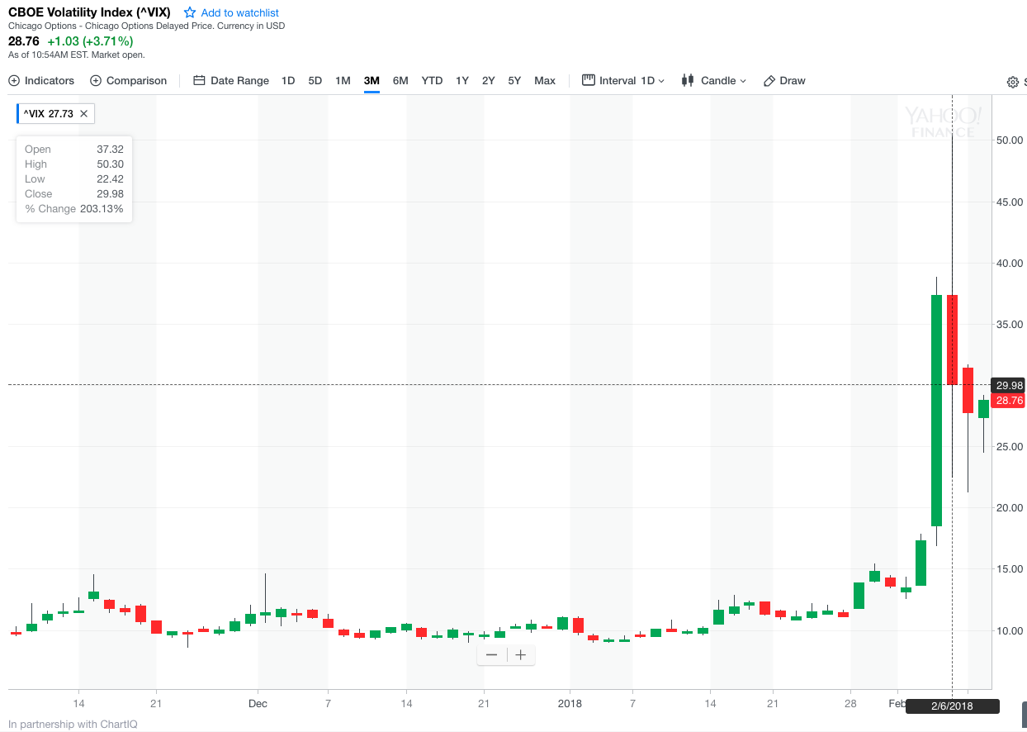
Project Motivation
“A pullback for this Teflon stock market could come like a thief in the night”
--- Robert Shiller, 1/23/2018

Slide 3
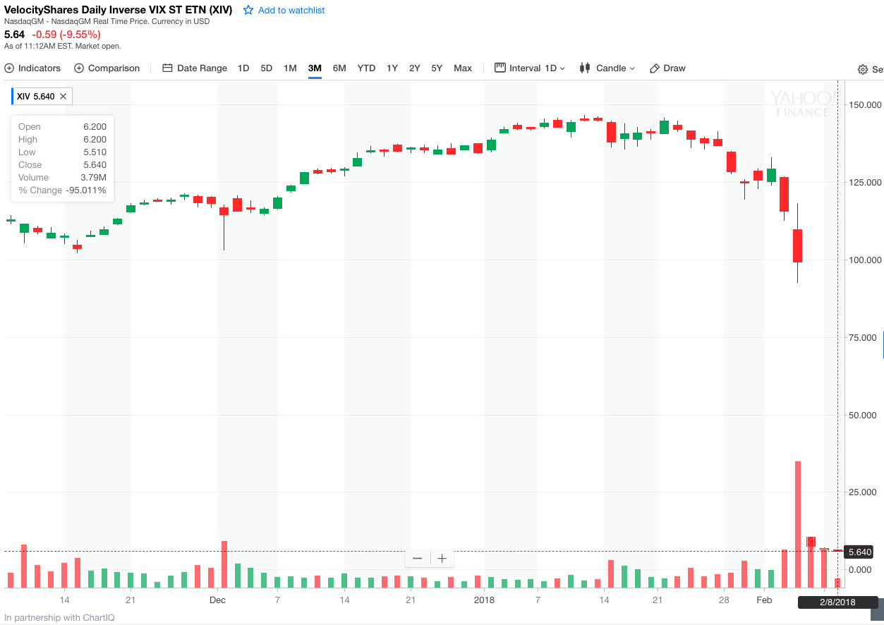
Project Motivation
Comparing Neural Network and GARCH models
Is Deep Learning a proper alternative (to GARCH) in volatility modeling/forecasting?

Slide 4
Project Introduction
Financial Risk Modeling With Deep Learning
Focus
Stock Return Volatility
S&P500 Sector ETFs
Objective/ Application
Neural Networks
Comparison with GARCH
Portfolio Allocation
Risk Management
Ticker | Sector
XLE | Energy
XLU | Utilities
XLK | Technology
XLB | Material
XLP | Consumer Staples
XLY | Consumer Discretionary
XLI | Industrials
XLV | Health Care
XLF | Financials
XLRE | Real Estate

Slide 5

Project Data
Data Acquisition And Processing
Time Frame: 1/1/2010 – Now
Source: Yahoo Finance
Data Format: daily adjusted closing price
Convert daily closing price into daily return (log return)
Volatility: standard deviation of stock return
Construct a 10-day rolling window

Slide 6
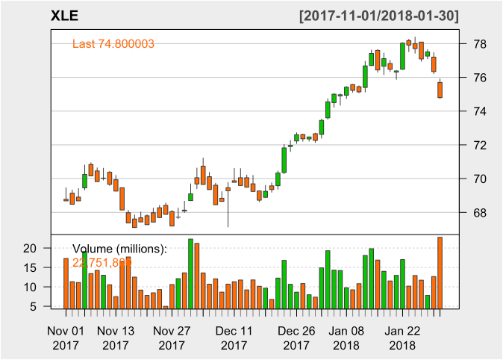
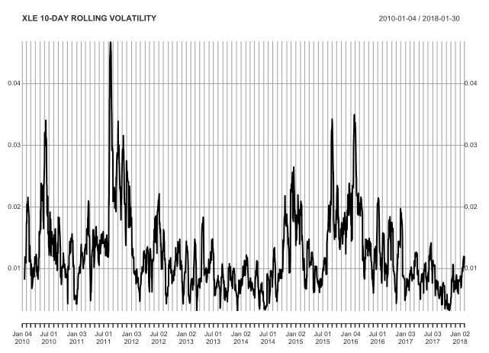
Data Visualization
Price Movement And Volatility Trend
Candlestick chart with volume
Rolling Volatility (std of return)
Shiny App
Live demo
shinyapps.io
https://huanghaotian1992.shinyapps.io/app_stocks/

Slide 7
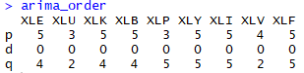
GARCH Models
ARMA GARCH
Test for stationarity
ARMA order
ACF and PACF
ARCH test
Box test
GARCH predict

Slide 8
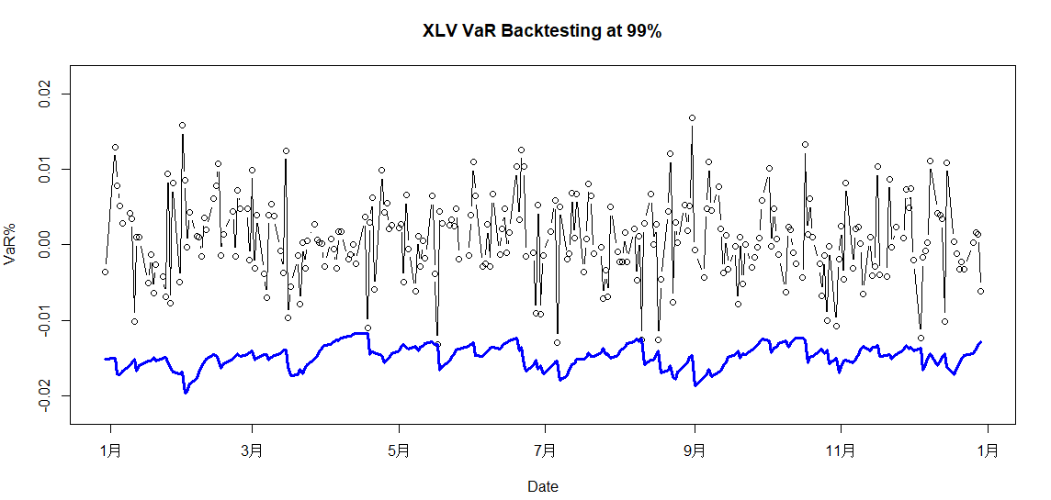
GARCH Predict
Model prediction vs. actual data

Slide 9
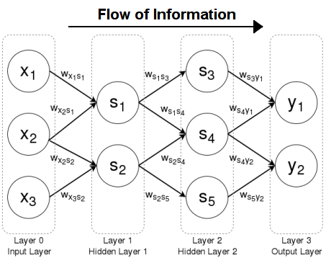
Neural Networks
TensorFlow
Data Input
Major sector components/holdings
Bond Yields
Exchange Rates (USD/JPY, EUR/USD)
Crude Oil Price
VIX
CPI, Sentiment, Employment Rate (TBD)
Feed Forward Neural Network
Optimize Cost/Loss Function (MAE, MSE, Cross Entropy, customized function)
Optimizer
Backpropagation
input → weights → hidden layer 1 (activation function) → weights → hidden layer 2 (activation function) → weights → output

Slide 10
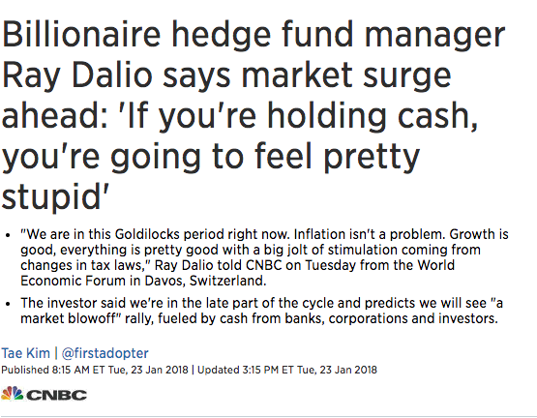
Next Step
Comparing Neural Network with other popular alternatives
More literature review on volatility forecasting and neural networks
More Data acquisition
GARCH Model cont’d
Basic neural network model
Platform: R and Python

Slide 11
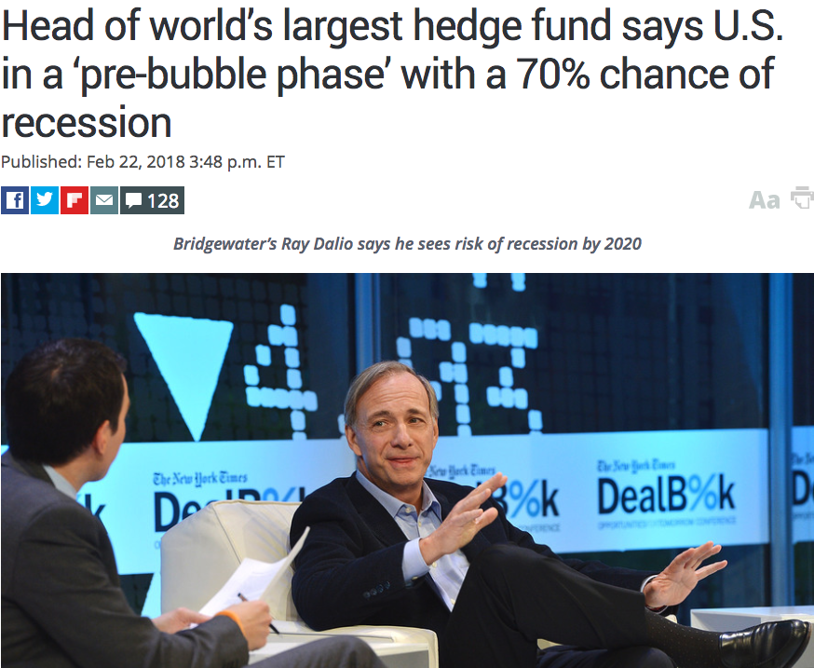
Key Milestones
3/8/2018: GARCH Final Result
3/22/2018: Neural networks shakedown
3/29/2018: Neural networks Test & Tune
4/5/2018 & 4/12/2018: Further application on corresponding options chains
Jiaji Dai: GARCH Models
Shuda Wang: Data Coordination
Huanghaotian Fu: Neural Networks

Slide 12
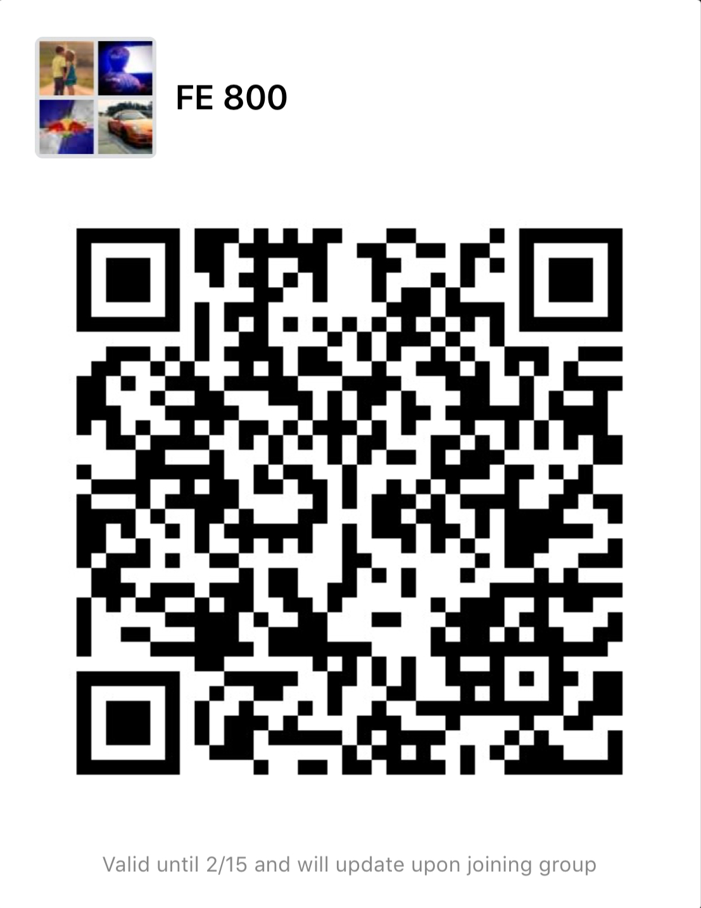
Team VIXXX
https://github.com/huanghaotian1992/FE800_Group_Project
hfu7@stevens.edu
917-903-9788 wechat: hwf5041

